Slide 1
ABN Amro Log Management RFP
Cognizant Response

Slide 2
Agenda
➔ | Executive Summary
➔ | Our Understanding
➔ | Cognizant Proposed Solution
➔ | Our Engagement Approach
➔ | Why Cognizant?
➔ | Our Recommendations
➔ | Sample Profiles
➔ | Case Studies

Slide 3
Executive Summary
ABN is Looking
To implement robust Log Management System
Proposed Solution
To meet rising business expectations
To implement Log Management platform which works well with existing set up
To build a scalable and reliable solution
Cognizant UAM framework with Splunk and TIBCO Loglogic Engine
The solution approach to ensure complete migration from XXX system by July 2014
ABNs long term interests and objectives are best served by a future ready Log Management platform
Ensure future scalability to thru dedicated ‘foundation’ track to develop solution component specifically targeted towards scalability
Value Delivered
Self monitoring solution to ensure high uptime of new system
Skin in the game. Dedicated UAM practice to deliver the solution.
Long established partnership with product vendors will accelerate issue resolution via in-house experts and high clout with product vendor
Cognizant will help establish enterprise logging architecture to multiply benefits to ABN
Reduced TCO and reduced ongoing support costs for ABN by intelligent pre-processors

Slide 4
Our Understanding

Slide 5
Our Understanding of ABN’s expectation is to…
develop a Log management solution aiming primary use cases of Application, Security and Compliancy management
migrate from Sensage, with side by side comparison
support for well defined authentication and authorization
provide a scalable log management architecture
integrate bi-directionally with HP Arcsight
cater to log growth pattern
Log volume of 50GB per day current and expected to grow up to 150GB per day in 2 years
plan against aggressive timeline (end of July 2014)
provide L2, L3 support by Solution Integrator
support Production with DR and QA environments

Slide 6
We recommend log management solution should have following considerations
Technical Considerations:
Migration from existing solution / platform
Any data movement expectations from current to new platform
Challenges with current platform and what is expected on the new solution
Platform overlaps
Integration with existing tools, solutions
Bi-directional data communication with HP ArcSight
Log Size and Growth
Log collection from different log sources
Current log volume
Growth expectation
Scalability and DR
Strategic Considerations:
TCO
To plan optimally and strategically on two distinctive cost categories, CAPEX and OPEX
Platform support
User community of the platform, extendable framework
Latency expectation aligning with business needs
Real-time considerations
With enterprise complex systems, sometimes it may be possible to achieve only near real-time
Development platform roadmap
To plan against any architectural changes expected as part of core platform roadmap which potentially can impact log management solution
Eco system considerations ( “ Source – Gartner, Keep the Five Functional Dimensions of APM Distinct, 16 September 2010, by Will Cappelli )
To achieve optimal APM effectiveness, enterprises must be prepared to implement multiple products, often from multiple vendors, even if it means greater architectural complexity and apparent functional overlap.

Slide 7

Strategic Solution Levers
Technology
THE COGNIZANT
Solution Levers
Extremely Competent team
Follow the Sun
Customized Onshore/Offshore model
On top of the technical tool/platform choice, Cognizant can help ABN with additional solution levers
UAM Framework
Out of the box features
(Estimation Template, Checklist, accelerators …)
Time to Market
Aggressive agile deliver for output driven implementation

Slide 8
Cognizant Solution Approach

Slide 9
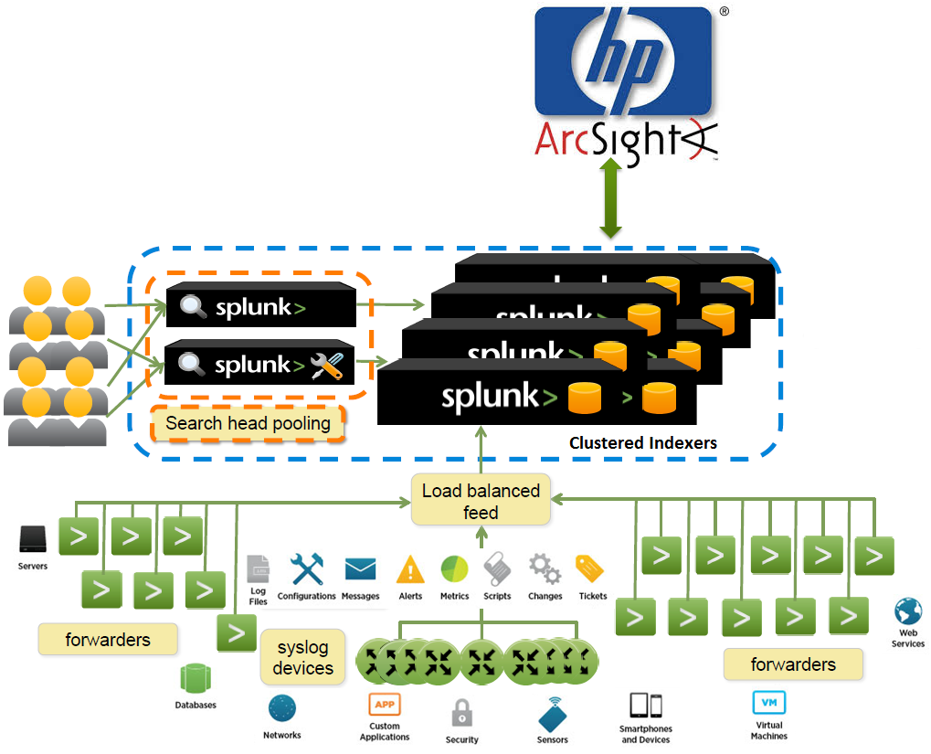
Solution: Splunk
Splunk light weight forwarders to be installed on production hosts and forwards the logs and raw events to Splunk Indexer
Splunk Indexer is a clustered component, which retrieves information from all different hosts and indexes the events
Log Filtering using defined patterns can be achieved during indexing phase
Splunk Search heads are the web UI component, clustered, providing user interface to interact with Splunk, including dashboards, reports, search
All different components of the architecture is highly scalable
Splunk’s map/reduce intelligence on indexer retrieves information very quickly
Splunk can integrate bi-directionally with HP ArcSight
SIEM - Enterprise Security App

Slide 10
Virtualization using Splunk
Splunk is geared for deploying in multiple fashion:
Public cloud
Private cloud
Hybrid cloud
Physical Datacenter
The source applications/middleware/dbs can be in-house or in cloud or hybird. Irrespective of how the setup is, Splunk can forward the logs and process them.
Splunk Cloud
If we would like to externalize complete splunk maintenance – setup, updates, scaling, etc Splunk Cloud is a choice
Splunk Enterprise can be consumed by customers as a service via Splunk Cloud an AWS cloud based service
No administrative and operational effort
Secure and Scalable
Splunk runs on most widely available operating systems including Windows and *NIX platforms (irrespective of virtualization choice)

Slide 11
Additional solutions to implement after discussion with ABN
New slide
We should include list of thought leadership items to improve solution beyond what is asked in RFP e.g.
runbook automation
self-healing
auto-ticketing
auto-resolution
All pointers should have 1-2 line brief desciptions

Slide 12
Self monitoring platform will monitor logging platform to ensure high availability
What are we watching? |  | Potential benefits
Monitor crash logs CPU utilization for searches | System Health | System uptime Easier problem diagnostics
Indexing performance and throughput (by source, source type, host, index) Correlate latency and data volume with the size of event processing queues. | Performance | Expose event processing bottlenecks. Resolve latency issues
Analyze data volume metrics captured by Splunk | License cost
Provide a layered view of the Splunk configuration files, allowing you to search and compare files side by side. | Development | Tools for faster monitoring dashboard development
Parse Splunk's internal logs to help expose errors and abnormal behavior | Processing errors
Provide analysis of dashboards most viewed, user activity, time to completion, and other related data for searches. | Insights on usages | Real time report on how system is used
Show performance and usage metrics for the search scheduler. Statistics on alert actions | System monitoring | System uptime
Changed slide title
Better uptime
Better performance
Cognizant team will build self monitoring system

Slide 13
Our Engagement Approach

Slide 14
Cognizant arrived at 3 prong solution strategy to implement complete solution that leads to meet ABN’s short term and long term goals
Engagement Approach
Concept team
Build team
Support team
1
2
3
Key parameters
Broad scope |  | Capture business requirements Design conceptual solutions | Build applications, implement core log mgmt product Design and deliver solution including up/down stream integration | Ensure solution is up and running within agreed business SLAs Admin tasks (platform and application) L2 and L3 support (8x5, Regular India working time, 2d SLA)
Primary interface |  | Within ABN: Business, Architecture, Developers, Security Within Cognizant: build team | Within ABN: Architecture, operations Within Cognizant: concept team, support team | Within ABN: operations Within Cognizant: build team
Team (finalize team size after estimating use cases and timeframe) |  | NL: 1x sr engg or data analyst India: 2x Engineer | NL: 1x Architect 1x Senior Engineer India: 1x Senior Engineer 2x Engineer (or as needed) | NL: 1x Engineer India: 2x Engineer (or as required)
Governance |  | 1x project manager (India)…. To interface with ABN project mgmt function Reports: weekly, monthly. Project specific and program level

Slide 15
Typical splunk application build steps and tasks (illustrative)
Strategy group
 | Application build tasks
Milestones > | Deployment planning | Discovery | Design / Setup | Implementation | Post production support | OCM
Activities > | Hardware sizing Collect non functional requirements (users, volume, storage etc) Identify topology and network scenarios Security plan (authentication, authorization and access control) Data collection methods Backup, archiving plan Deployment plan | Agree on biz goals Data source analysis Log and field analysis Integration points, volume analysis Requirements on dashboards / notifications Define POC | Design data models Ensure data sources adequacy Environment Setup changes POC (if new concepts only) Demo/Review Core aspects of Sample use case development Capacity re-estimation | Performance components Dashboard developments, reviews Configuration, Notification, Alerts Integration with enterprise systems Technical reviews, decisions | Resolve tickets | Train users Org change mgmt activities (communication, before/after documentation) User feedback analysis
Timeline > | 1-2 weeks | 1-3 week sprints | Each sprint of 3- 7 weeks |  | Ongoing
ABN inputs > | Provide Access, Hardware, Periodic reviews/feedbacks, Agree on Technical decisions, Define solution expectations, Attend weekly status meetings, SME support on other solutions to be integrated

Slide 16


Project plan with key tasks for migration and implementation
Use cases
Different time scale
Weeks →
Pre-plan | 1 | 2 | 3 | 4 | 5 | 6 | 7 | 8 | 9 | 10 | 11 | 12 | 13 | 14 | … | 6mo | 9mo
Project start
Detail migration plan
Users migration
Evaluate enterprise integration
Sensage migration
Decide scope
Deployment
Migration complete
Configuration
Testing & acceptance
Log/ reports mapping
Architecture
Support planning & agreements
L2, L3 support (for migration)
Other use cases
Determine scope
L2, L3 support
Evaluate enterprise integration
Enterprise test plan
Ent testing
Foundation & config
h/w planning
Architecture
NFR
Users create / migrate
Performance Optimization
Enterprise integration
Security & Auth
Configuration
Application build out
Deployment
OCM – training, communication, …
OCM
Support planning & agreements
Project start
Build Apps (delivered every 3-7 week sprints)

Slide 17
Risks and Mitigation Plan
Who is current vendor to transfer from? Is this real risk?
Add risks. (not exhaustive list)
ABN fails to seek adquate product support from product vendor
Use case definition takes long time or various ABN business entities fail to converge
System performance is low
Risk | Impact | Mitigation Strategy
Knowledge transfer from current vendor | High | Detailed knowledge transfer strategy in consultation with ABN Executive leadership support from ABN and Cognizant
Availability of SME from ABN during Elaboration | High | Identification of SMEs before start of Elaboration phase Publish detailed elaboration plan with ABN, blocking SME calendars
Delay in Hardware procurement | Medium | Sharing detailed Project plan with ABN Sharing Hardware requirements with ABN well in advance

Slide 18
Our Experience

Slide 19
What We Do In The Machine Data and Log Management Landscape
Implementation
Integration
Advanced Customization
Architecture
Sizing
Installation
Configuration Management
Dashboards, Reports
Apps
Enterprise Application Integration
Runbook Integration
Auto-ticketing, Auto-resolution
App/Infra Correlation
Smart Monitoring Instrumentation
Consulting
Machine Data Strategy
Log Management Strategy
Support
Product Support
Enterprise Implementation Support

Slide 20



Log Management Practice Overview
30 Certified Architects on Leading Log Management Products
75 Trained Architects
80 Trained Engineers
37 complex engagements
Ready to use Log Management Framework
Extensive hands on experience in BFSI industry
Strong Industry partnerships with leading players in Log Management space
Strong Relationship with Log Management Product Vendors
Customer Focused Global Delivery Capability
End-to-End Service Offerings
Presence across the globe with multiple nearshore & offshore delivery centers
Delivery Assurance with C2.0
Verticalized structure
‘Best-in-Class’ Delivery model
Global Services Partnerships with leading Log Management Product vendors
Strategic Partner for Splunk and TIBCO for Global Delivery
Strategic partnership with Splunk and TIBCO for product implementation, customization and development.
Service offerings aligned with the entire Splunk Product suite
Consulting Capabilities
Business Transformation
Managed Services
On-Demand Services

Slide 21
Why Us?
Any Data
Completely Flexible
Rapid Results
Any format of data, from any source
Full access to 100% of data for months/years
Cradle to grave data management
Support any analysis, reporting or monitoring across IT silos
Highly Flexible dashboards
Adapts to change
Easy to install
Extremely scalable
Realize value in no time
UAM

Slide 22
Our Recommendations

Slide 23
We recommend detailed log management strategy at enterprise level, if not done already
Central log collection and management with following strategies
Strategy for events filtration, aggregation, normalization
How to determine useful/un-useful events
Coverage and scope
What systems and events must be logged
What information must be logged
Deployment specific logging variation e.g. dev vs production
Protected network
Log storage strategy
Log retention, archiving requirements
Service level agreements by enterprise functions e.g. system owners, security, infrastructure
For security related events, define standard response to events of interests
Minimum monitoring requirements, responsibility metrics
Reporting requirements
Compliance (if any) requirements, reporting
Audit trail requirements

Slide 24
Our Splunk Partnership

Slide 25
Cognizant’s Partnership With Splunk
No financial gain relationship
Core team of 100+ Splunk Certified Architects/Engineers in across the globe
Active Splunk implementation, customization pipeline
Dedicated Splunk architecture, implementation, customization and support team - not fly by night engineers who also do Splunk
Aligned with Cognizant’s DevOps+ vision
“
Cognizant and Splunk are working together with our joint customers to make their data more usable and valuable. We have a strong partnership with Cognizant. I believe Splunk’s platform and Cognizant’s consulting expertise provides a great combination to our customers.
- Ashwin Kedia, AVP Business Development at Splunk Inc.
”

Slide 26
A Quick Solution Comparison

Slide 27
High Level Functional Comparison*
Functional requirements | Splunk | Loglogic
Log Management | 4.5 | 4.5
Log Search | 4.5 | 4
Enterprise Security (SIEM) | 4.6 | 4.1
Business Application Monitoring | 4.5 | 4
Operational Intelligence | 4.6 | 3.9
Cost | 3.9 | 4
UI Visualization, Dashboards, Reports, drill down | 4 | 4.3
Setup, Installation and maintenance | 4.5 | 3.9
Scaling | 4.9 | 4
* The comparison is done by our expert team on a scale of 1 to 5 where 1 is worst and 5 is Excellent

Slide 28
Sample Profiles

Slide 29
Sample Profiles
Name | Role | Experience
Ganesh Nallaswamy | Architect | Ganesh is a Splunk Architect and J2EE Subject Matter Expert (SME) who has 7.8 years of experience in managing, implementing and supporting large Scale Application projects including Splunk implementation. He has thorough experience on software development methodology and Quality Process. Worked in various projects adhering to different phases of software development life cycle (Waterfall, Agile) which includes study, analysis, design, development, testing, implementation and support. He is proficient in Splunk server/forwarder configuration and application development which includes customization of html and java script. He created more application, Dashboard for MetLife and TIAA Insurance for the pilot project and it was greatly appreciated. He also involved in Splunk REST API integration and authentication using LDAP and Single Sign-on for Splunk. He is holding Splunk certification Architecting and Deploying for Splunk, Advanced Splunk Administration.
N Arun | Senior Engineer | Arun Nagaraju is a Splunk Engineer who has almost 2 years of experience in Splunk App development and Administration. He worked in Splunk related technologies like Splunk Java SDK, Splunk Python SDK, Python, Django Framework, Mako templates, Splunk Simple and Advanced XMLs. He has thorough experience on Object oriented development (Java) methodology and Quality Process. He also worked as Splunk Administrator in Big Telecommunication Client for 1.5 year.

Slide 30
Sample Profiles
Name | Role | Experience
Ganesh Nallaswamy | Architect | Ganesh is a Splunk Architect and J2EE Subject Matter Expert (SME) who has 7.8 years of experience in managing, implementing and supporting large Scale Application projects including Splunk implementation. He has thorough experience on software development methodology and Quality Process. Worked in various projects adhering to different phases of software development life cycle (Waterfall, Agile) which includes study, analysis, design, development, testing, implementation and support. He is proficient in Splunk server/forwarder configuration and application development which includes customization of html and java script. He created more application, Dashboard for MetLife and TIAA Insurance for the pilot project and it was greatly appreciated. He also involved in Splunk REST API integration and authentication using LDAP and Single Sign-on for Splunk. He is holding Splunk certification Architecting and Deploying for Splunk, Advanced Splunk Administration.
N Arun | Senior Engineer | Arun Nagaraju is a Splunk Engineer who has almost 2 years of experience in Splunk App development and Administration. He worked in Splunk related technologies like Splunk Java SDK, Splunk Python SDK, Python, Django Framework, Mako templates, Splunk Simple and Advanced XMLs. He has thorough experience on Object oriented development (Java) methodology and Quality Process. He also worked as Splunk Administrator in Big Telecommunication Client for 1.5 year.

Slide 31
Case Studies

Slide 32
Case Study – Quality Analysis
Customer Information
Problem Statement
Client is the Internet's ultimate automotive marketplace
As a leading resource for car shoppers and sellers, the web properties aggregate millions of new, used and certified pre-owned cars from thousands of dealers and private sellers and provides expert articles and reviews
Proprietary tag management framework used for web analytics.
Tags used exclusively for sales reports prepared and consumed by field sales teams
Frequent breakdown of sales reports due to missing and incorrect tags.
No inventory of tags or a golden reference system
No proactive mechanism to detect web analytics framework and/or sales reports failure
Solution Model
A high performing light weight search solution, integrating weblogs and EDW data
Implemented a Splunk based analysis and visualization system involving Splunk architecture, implementation, and customization
Customized Cognizant proprietary solutions for
Real time data extraction and plumbing
Data optimization
Business specific visualization, monitoring and reporting patterns
Business Benefit
100GB of web analytics machine data extracted, cleaned and fed into a Splunk based solution
Inventory of web analytics tags achieved with a 98.5% accuracy
100% accuracy on new product web analytics
22 real time visualization dashboards for multiple time-series patterns

Slide 33
Case Study – Business SLA
Customer Information
Problem Statement
Client is a leading global payment processing company
Provider of e-commerce and payment solutions to manage merchant transactions processing services credit, debit, private-label, gift, payroll and other prepaid card offerings; fraud protection and authentication solutions, credit reporting agency services
Runs multiple batch jobs which has tight correlation
Client is to provide an enhanced service quality and ensure as an organization matches the business expectation.
The concept is to offer monitoring and supervision functions by gathering operational data, aggregate it , correlate the information and deliver Key Performance Indicator.
A part of concept is provide a dashboard reporting to all levels of management on health check of key processes, applications and critical areas.
The dashboard should also have enhanced capability to provide data driven decisions, report on delays & failures, proactive alerting and predictive monitoring functions.
Solution Model
The data is spread across multiple systems including DB2, Cycle view, batch job logs, SQL Server DB
Effective data model created by defining the event correlations between the systems to capture
Batch job dependencies
Batch execution (start, end, pause)
Batch execution path
Historical data
Cycle view pull
Splunk integrated with cycle view tool to continue to use cycle view and trigger processes in cycle view from Splunk
Individual batch job thresholds are captured from historical data points to define alerting levels
Business Benefit
Single view of metrics from 60GB daily data load into Splunk from various data sources and log data from batch execution
Saved $50,000 per month in reducing penalties (Client pays $50-$100k penalties in missing SLAs) – Prediction of business SLA delays, Self Heals helped.
Plan to retire cycle view, SQL Server DB in 8 weeks, saves cost on tool and maintenance – estimated to be $20,000 per month

Slide 34






Business SLA Prediction
Load File
Batch 1
Batch 3
Batch 4
1108 EST
Business
SLA
1030 EST
1100 EST
Batch 2
1112 EST
1119 EST 1130 EST 1200 EST
Cut File
Adds 10mins delay
Adds 12mins delay
40
Apps
ESB
DB
MW
Apps
ESB
DB
MW
Apps
ESB
DB
MW
Apps
ESB
DB
MW
Apps
ESB
DB
MW
25
Platform
Platform
Platform
Platform
Platform
Actual
Time
20
Operating System
Operating System
Operating System
Operating System
Operating System
15
Hardware
Hardware
Hardware
Hardware
Hardware
Time Prediction
1134 EST
Time Prediction
1206 EST
L
How?
Solution?
Transaction SLA can be defined as ideal time taken by Subsystem to complete the transaction.
Business SLA is predicted by historical data, execution time for each subsystem, time taken within threshold
Splunk, alerts during delays, failures and predicts revised SLA
The business SLA prediction helps to pro-actively monitor and predict the ETA for orders / transactions.
Apply prediction and Self Heal to move to Level 4 maturity.
Inbound Flow
Outbound Flow
Process Delay

Slide 35




Self Heal using Splunk
Use Case
How?
Monitoring the folder which contains User technical specs in Unix file system.
Based on the space utilization alert in the folder triggering archival process to move older files (older than X number of years) into different system.
Splunk executes command on target Server to fetch file system state periodically.
System state will be indexed and stored in Splunk.
Splunk will be monitoring the state against the conditions defined.
When specific conditions are met then Splunk will trigger respective scripts to modify the target file system.
Operation’s Person
System Support Person
Activities:
Triage
Disk maxed out?
Action
Today
notifies
Unix Machine
Unix Machine
Runs Archival
Unix Machine
Manual
Splunk
Over a period of Time
If Condition met
Self Heal by Archival
Using Splunk
Solution Model
Solution Model
Whenever space issue happens , additional space is added to the file system .
A new command will be created to fetch folder state info and then it will be indexed in Splunk.
Splunk daemon will be monitoring the folder size constantly.
When folder size reaches the configured threshold then Archival process script will be triggered by Splunk.
Script will move the files which are older than X(configured) number of years to another file system.

Slide 36
Cognizant Team
Role | US | UK and CE | APAC
Business Leader | Vilas Patil
Practice Leader | Kapil Apshankar
Practice Architects | Murali Gurumoorthy | Vaibhav Joshi | Rajkumar Chandrasekharan
 | Ronald Naik | Dharmin Shah | Mubeen Shaikh
Practice Engineers | 48 | 27 | 250+

